Slide 1
Review 2

Slide 2
if-else Statement Syntax
Formal syntax: if (<boolean_expression>) <yes_statement> else <no_statement>
if (i % 2 == 0) {
cout << “i is an even number. “ << endl;
}
else {
cout << “i is an odd number. “ << endl;
}

Slide 3
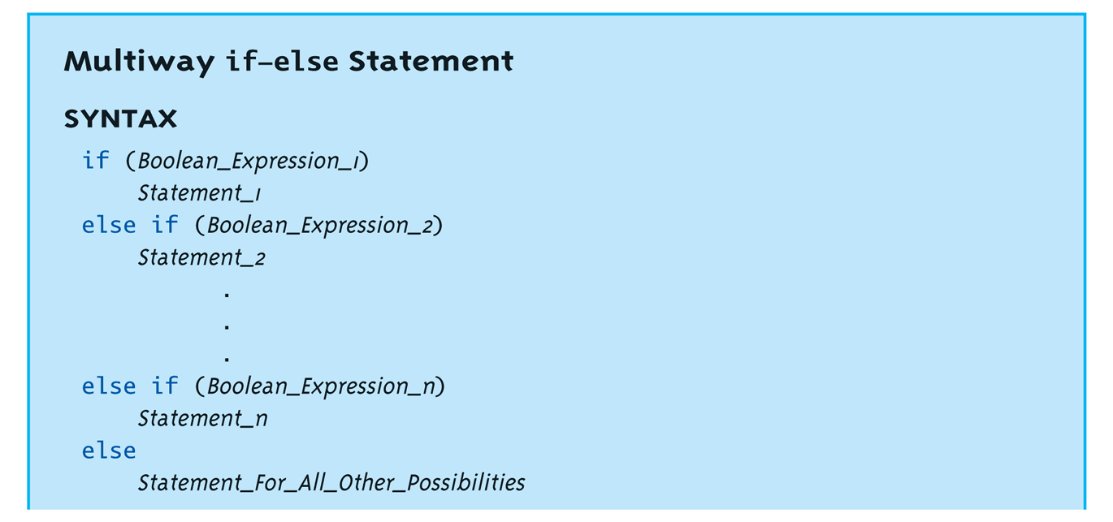
Multiway if-else
if (condition 1) {
if (condition 2) {
if (condition 3) {
statement 1
}
else {
statement 2
}
}
}
else {
if (condition 4) {
if (condition 5) {
statement 3
}
else {
statement 4
}
}
}
Not new, just different indenting
Avoids "excessive" indenting
Syntax:

Slide 4
How to implement the case when only multiple conditions are satisfied, the following code will be executed?
yt
For instance, determine whether a given point falls within a square region
[xl, xr] X [yb, yt]
(x,y)
yb
xl
xr

Slide 5
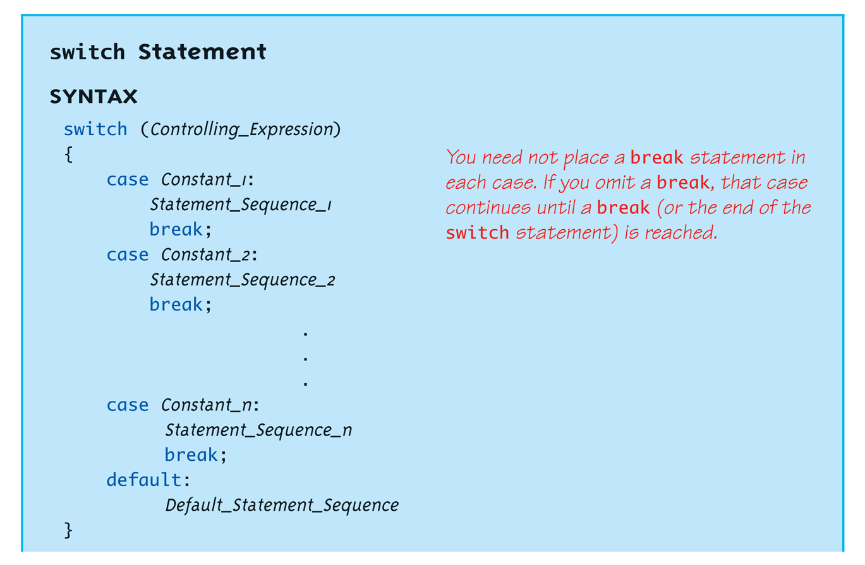
switch Statement Syntax
The controlling expression must be integral! This includes char.
Do you still remember in what situation switch statement is good at?

Slide 6
switch Menu Example
Switch stmt "perfect" for menus: switch (response) { case 1: // Execute menu option 1 break; case 2: // Execute menu option 2 break; case 3: // Execute menu option 3 break; default: cout << "Please enter valid response."; }

Slide 7
Loops
Why do we need loops?

Slide 8
Loops
3 Types of loops in C++
while
Most flexible
No "restrictions"
do-while
Least flexible
Always executes loop body at least once
for
Natural "counting" loop

Slide 9
for Loop Syntax
for (Init_Action; Bool_Exp; Update_Action)
Body_Statement
Good for the situations that the exact or maximum number of iterations is known!!!
Example: compute the sum of numbers 1,2, 3,…, 100
#include <iostream>
using namespace std;
int main()
{
int x = 0;
int i;
for (i=1; i<=100; i++)
{
x += i;
}
cout << "the sum of 1 to 100 is " << x << endl;
}

Slide 10
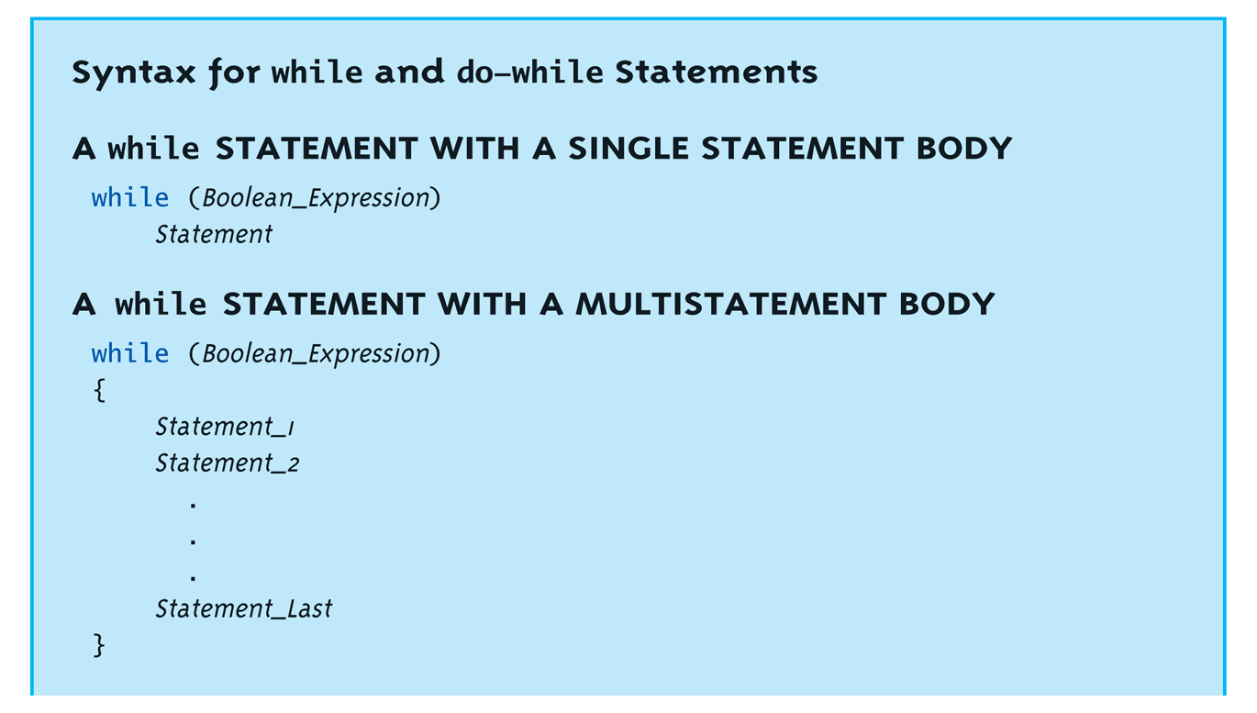
while Loops Syntax
count = 0; // Initialization while (count < 3) // Loop Condition { cout << "Hi "; // Loop Body count++; // Update expression }

Slide 11
#include <iostream>
using namespace std;
int main()
{
int x = 0;
int i;
for (i=1; i<=100; i++)
{
x += i;
}
cout << "the sum of 1 to 100 is " << x << endl;
}
Can you implement the above for loop example using while or do-while mechanism?

Slide 12
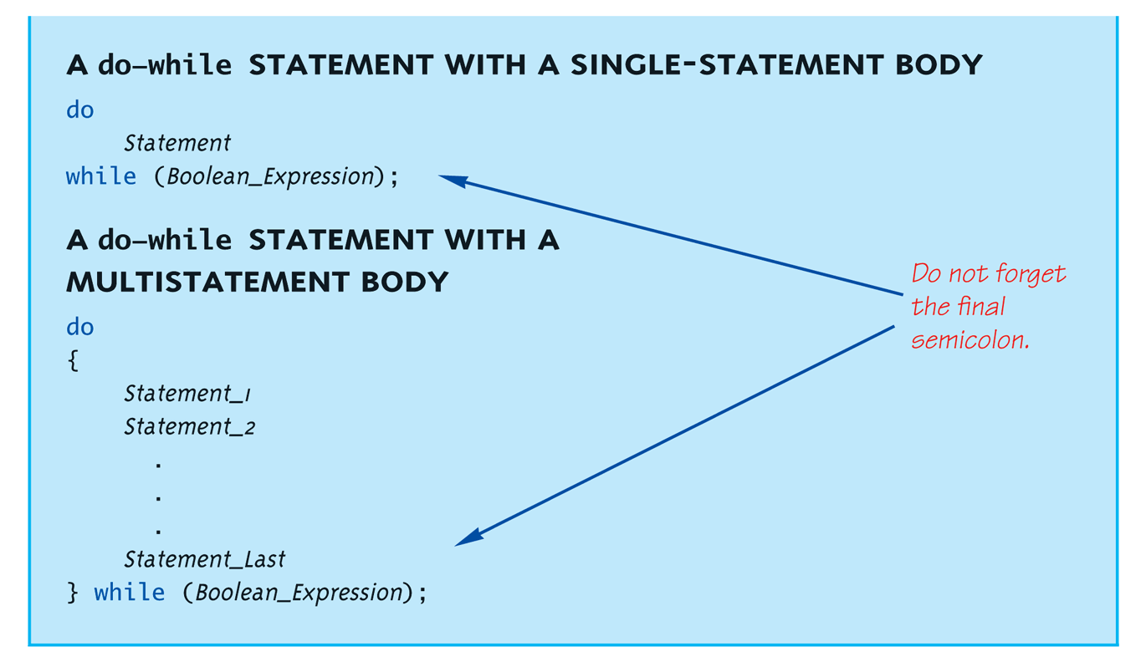
do-while Loop Syntax

Slide 13
do-while Loop Example
do-while loops always execute body at least once!
count = 0; // Initialization do { cout << "Hi "; // Loop Body count++; // Update expression } while (count < 3); // Loop Condition
Loop body executes how many times?
In what situation do-while will be useful?

Slide 14
Consider a program that allows the user three attempts to input her/his correct username and password before freezing the user’s account.
How will you implement it?

Slide 15
Consider a program that allows the user three attempts to input her/his correct username and password before freezing the user’s account.
How will you implement it?
Using for loop
for (int i = 0; i<3; i++)
{
// accept user input
// if input matches the record in the database, exit the loop
// otherwise, next attempt
}
This is a small algorithm!

Slide 16
Consider a program that allows the user three attempts to input her/his correct username and password before freezing the user’s account.
How will you implement it?
Using while loop
int i = 0;
while (i<3)
{
// accept user input
// if input matches the record in the database, exit the loop
// otherwise, next attempt
i ++;
}

Slide 17
Consider a program that allows the user three attempts to input her/his correct username and password before freezing the user’s account.
How will you implement it?
What if I do not set a limit of how many attempts the user can have?
Using while loop
while (if input does not match the record in the database)
{
// accept user input
}
Will there be an issue?

Slide 18
Consider a program that allows the user three attempts to input her/his correct username and password before freezing the user’s account.
How will you implement it?
What if I do not set a limit of how many attempts the user can have?
Using while loop
while (if input does not match the record in the database)
{
// accept user input
}
The user has to provide at least one input before the above condition can be checked!

Slide 19
Consider a program that allows the user three attempts to input her/his correct username and password before freezing the user’s account.
How will you implement it?
What if I do not set a limit of how many attempts the user can have?
Using do-while loop
do
{
// accept user input
} while (if input does not match the record in the database) ;
The user has to provide at least one input before the above condition can be checked!
Can for and while loop not achieve the above functionality?

Slide 20
The break and continue Statements
Flow of Control
Recall how loops provide "graceful" and clear flow of control in and out
In RARE instances, can alter natural flow
break;
Forces loop to exit immediately.
continue;
Skips rest of loop body
These statements violate natural flow
Only used when absolutely necessary!

Slide 21
Nested Loops
Recall: ANY valid C++ statements can be inside body of loop
This includes additional loop statements!
Called "nested loops"
Requires careful indenting: for (outer=0; outer<5; outer++) for (inner=7; inner>2; inner--) cout << outer << inner;
Notice no { } since each body is one statement
Good style dictates we use { } anyway

Slide 22
What typical issues you may see when using loops??

Slide 23
What typical issues you may see when using loops??
Infinite loops, program never ends
Exits loop unexpectedly
Incorrect number of iterations
Other reasons??

Slide 24
Arrays
Why do we need arrays?

Slide 25
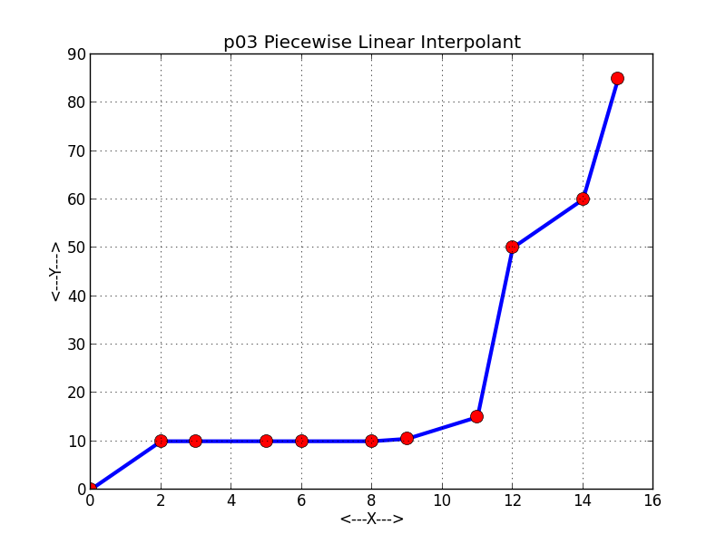
Array Usage
Powerful storage mechanism
What you can do with arrays?
"Do this to i^{th} indexed variable" where i is computed by program
"Display all elements of array score"
"Fill elements of array score from user input"
"Find highest value in array score"
"Find lowest value in array score"

Slide 26
Declaring Arrays
Declare the array → allocates memory
int score[5];
Declares array of 5 integers named "score"
Similar to declaring five variables: int score[0], score[1], score[2], score[3], score[4]
Individual parts called many things:
Indexed or subscripted variables
"Elements" of the array
Value in brackets called index or subscript
Numbered from 0 to size - 1

Slide 27
Accessing Arrays
Access using index/subscript
cout << score[3];
Note two uses of brackets:
In declaration, specifies SIZE of array
Anywhere else, specifies a subscript
Size, subscript need not be literal
int score[MAX_SCORES];
score[n+1] = 99;
If n is 2, identical to: score[3]
index – integer

Slide 28
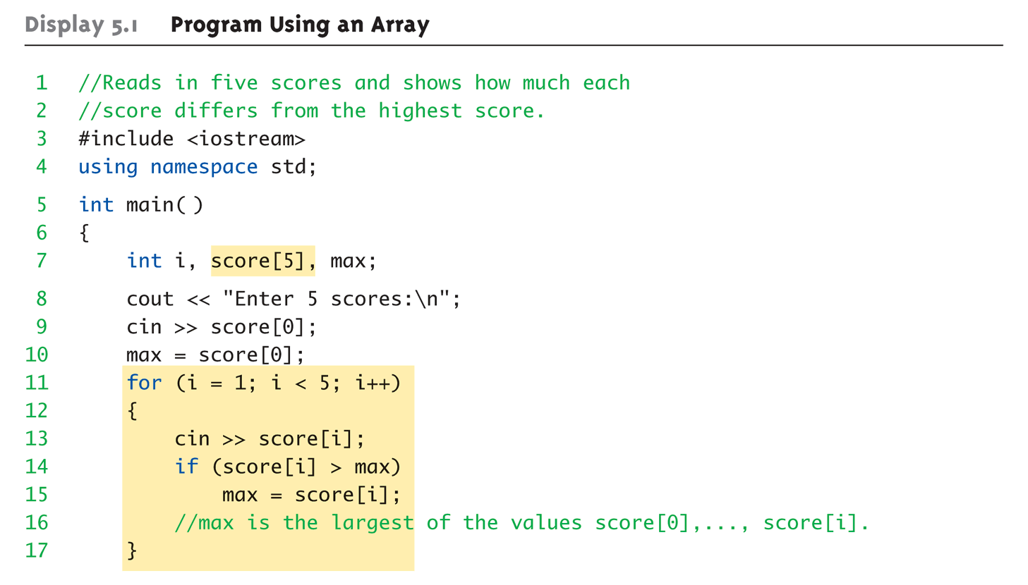
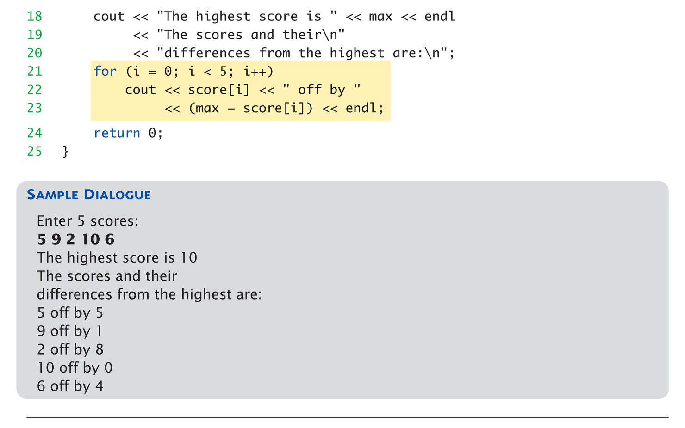

Slide 29
for-loops with Arrays (very typical!!)
Natural counting loop
Naturally works well "counting through" elements of an array
Example: for (idx = 0; idx<5; idx++) { cout << score[idx] << "off by " << max – score[idx] << endl; }
Loop control variable (idx) counts from 0 – 5

Slide 30
Initializing Arrays
As simple variables can be initialized at declaration: int price = 0; // 0 is initial value
Arrays can as well: int children[3] = {2, 12, 1};
Equivalent to following: int children[3]; children[0] = 2; children[1] = 12; children[2] = 1;

Slide 31
Auto-Initializing Arrays
If fewer values than size supplied:
Fills from beginning
Fills "rest" with zero of array base type
If array-size is left out
Declares array with size required based on number of initialization values
Example: int b[] = {5, 12, 11};
Allocates array b to size 3

Slide 32
Major Array Pitfall
Array indexes always start with zero!
Zero is "first" number to computer scientists
C++ will "let" you go beyond range
Unpredictable results
Compiler will not detect these errors!
Up to programmer to "stay in range"

Slide 33
Major Array Pitfall Example
Indexes range from 0 to (array_size – 1)
Example: double temperature[24]; // 24 is array size // Declares array of 24 double values called temperature
They are indexed as: temperature[0], temperature[1] … temperature[23]
Common mistake: temperature[24] = 5;
Index 24 is "out of range"!
No warning, possibly disastrous results

Slide 34
Uses of Defined Constant
Use everywhere size of array is needed
In for-loop for traversal: for (idx = 0; idx < NUMBER_OF_STUDENTS; idx++) { // Manipulate array }
In calculations involving size: lastIndex = (NUMBER_OF_STUDENTS – 1);
When passing array to functions (later)
BENEFIT: if size changes → requires only ONE change in program!

Slide 35
Auto-Initializing Arrays
If fewer values than size supplied:
Fills from beginning
Fills "rest" with zero of array base type
If array-size is left out
Declares array with size required based on number of initialization values
Example: int b[] = {5, 12, 11};
Allocates array b to size 3
5 | 12 | 11

Slide 36
Ranged-Based For Loop
The C++11 ranged-based for loop makes it easy to iterate over each element in a loop
Format
Example
for (datatype varname : array) { // varname is set to each successive
// element in the array }
int arr[] = {20, 30, 40, 50};
for (int x : arr) cout << x << " "; cout << endl;
Output: 20 30 40 50

Slide 37
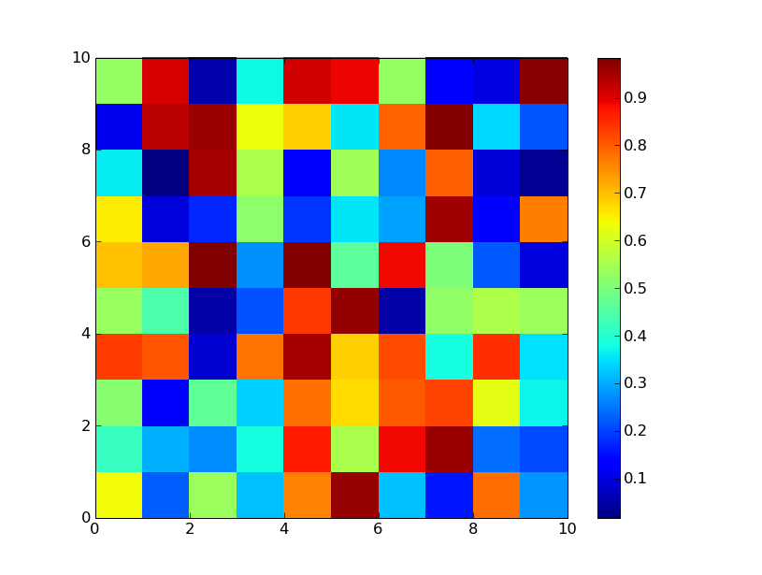
Multidimensional Arrays
Arrays with more than one index
char page[30][100];
Two indexes: An "array of arrays"
Visualize as: page[0][0], page[0][1], …, page[0][99] page[1][0], page[1][1], …, page[1][99] … page[29][0], page[29][1], …, page[29][99]
C++ allows any number of indexes
Typically no more than two

Slide 38
Pointers and Dynamic Arrays

Slide 39
The concept of pointers is one of the most powerful fundamentals of C/C++ language.
1001
2471
123
1001
normal variable
pointer
Through pointers a developer can directly access memory from his/her code which makes memory related operations very fast. But, as always, with great power comes great responsibility.

Slide 40
How to declare a pointer?
<pointer type> *pointer_name;
pointer-type : It specifies the type of pointer. It can be int,char, float etc. This type specifies the type of variable whose address this pointer can store.
pointer-name : It can be any name specified by the user. Professionally, there are some coding styles which every code follows. The pointer names commonly start with ‘p’ or end with ‘ptr’.
int *my_ptr;
double *num_ptr;

Slide 41
How to initialize a Pointer?
A pointer is initialized in the following way :
pointer_name = <address of a variable>;
or
<pointer type> *pointer_name = <address of a variable>;
int a_int = 0;
double num_double = 3.0;
int *my_ptr = &a_int;
double *num_ptr = &num_double;
int a_int = 0;
double num_double = 3.0;
int *my_ptr;
my_ptr = &a_int;
double *num_ptr;
num_ptr = &num_double;
Note that the ‘&’ operator is used to access the address of any type of variable.

Slide 42
How to use a Pointer?
For accessing the address of the variable whose memory address the pointer stores.
int a_int = 0;
int *my_ptr = &a_int;
2345
2345
0
my_ptr
a_int
2. For accessing the value of the variable whose memory address the pointer stores.
int a_int = 0;
int *my_ptr = &a_int;
*my_ptr = 1;
cout << “the value is “ << *my_ptr;
What does this asterisk operator do?

Slide 43
Pointers to arrays
As to any kind of data type, we can have pointers to arrays also. A pointer to array is declared as
<pointer type> *pointer_name = array_name;
or
pointer_name = array_name;
1204
1204
my_ptr
arr_int[0]
int arr_int [] = {1,2,3,4,5,6};
int *my_ptr = arr_int;
int arr_int [] = {1,2,3,4,5,6};
int *my_ptr;
my_ptr = arr_int;
Note there is no ‘&’ operator in front of the array name!!!
It points to the first element of the array

